Slide 1

Metavelvet Overview
Atiq Israk Niloy
Researcher
Metagenomic Assembly
Southeast University
atiqisrak@gmail.com
A Presentation on the Metagenomic Assembly Assembler

Slide 2
Abstract and Introduction
A limitation of a single-genome assembler for de novo metagenome assembly is that sequences of highly abundant species are likely misidentified as repeats in a single genome, resulting in a number of small fragmented scaffolds.
The de Bruijn graph-based assembly program identifies the overlaps between reads using a de Bruijn graph and merges the reads to reconstruct longer sequences.
Our fundamental strategy for metagenome assembly was to consider that a de Bruijn graph constructed from mixed sequence reads of multiple species is equivalent to the mixture of multiple de Bruijn subgraphs, each of which is constructed from sequence reads of individual species and to decompose the mixed de Bruijn graph into individual subgraphs and build scaffolds based on each decomposed subgraph
We made use of two features, the coverage (abundance) difference and graph connectivity, for the decomposition of the de Bruijn graph.
5. For simulated datasets, MetaVelvet succeeded in generating significantly higher N 50 scores than any single-genome assemblers.

Slide 3
Abstract and Introduction
If use Single genome assembler > de novo > misidentified species > many small fragmented scaffolds > limitation
Overlaps between reads > De Bruijn > Reconstruct longer sequences.
Mixed species > a de Bruijn graph = Multiple de Bruijn sub graphs
Each subgraph = sequence reads of individual species
Decompose mixed de Bruijn > Individual Sub graphs > Build scaffolds
To decompose > Used Coverage difference & Graph Connectivity
Generates N 50 scores => any single-genome assemblers

Slide 4
Materials & Methods
Need to Discuss
In Velvet, the de Bruijn graph is implemented slightly differently, such that each node represents a series of overlapping k-mers where adjacent k-mers overlap by k 1 nucleotides.
The ordered set is cut whenever an overlap with another read begins or ends. a node is created. Two nodes can be connected by a directed edge. If two nodes are connected, the last k-mer of an origin node overlaps by k 1 nucleotides with the first of its destination node. New directed edges are created by tracing the read through the constructed graph.
Second, Velvet executes three functions, ‘simplification’ for node merging, and ‘removing tips’ and ‘removing bubbles’ for error removal.

Slide 5
Process
DNA Sequence input >
Merge Overlaps > Repeat

Slide 6
Read
Sequence fragment

Slide 7
Contig
Loger Sequence

Slide 8
Tip
Chain of nodes > One end disconnected

Slide 9
Bubble
2 redundant paths > start+end point > Contain similar sequences

Slide 10
Tips & Bubble
Tips and bubbles are
created by sequencing errors or biological variants, such
as single nucleotide polymorphisms (SNPs).

Slide 11
Pebble &
Rock Band
Called for constructing the scaffold and for repeat resolution using paired-end information and long read information

Slide 12
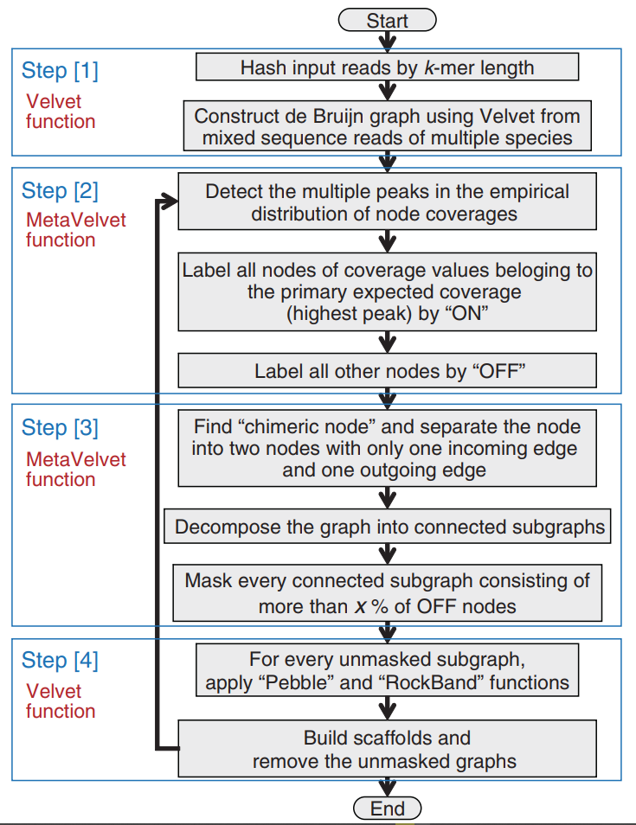

Slide 13
Process de Velvet
02
Uninterrupted
01
03
Cutting
Connect Nodes
Create node of the original uninterrupted subset.
The ordered set is cut whenever an overlap with another read begins or ends.
Connects 2 nodes by joining K of the first node with K-1 of the previous one.

Slide 14
3 Functions
05
Tip removal
04
06
Simplification
Bubble
Chain of nodes disconnected on one end is removed.
Join 1 ending and 1 beginning edge
Loops are merged

Slide 15
Metavelvet
01
03
02
04
Decomposition of the constructed de
Bruijn graph into individual subgraphs.
Construction of a de Bruijn graph from the input reads.
Detection of multiple peaks on k-mer frequency
distribution.
Assembly of
contigs and scaffolds based on the decomposed subgraphs.

Slide 16
Chimeric Nodes
Shared Nodes

Slide 17
Compared with
Velvet
SOAP
Meta-IDBA
Meta Velvet Performed the best

Slide 18
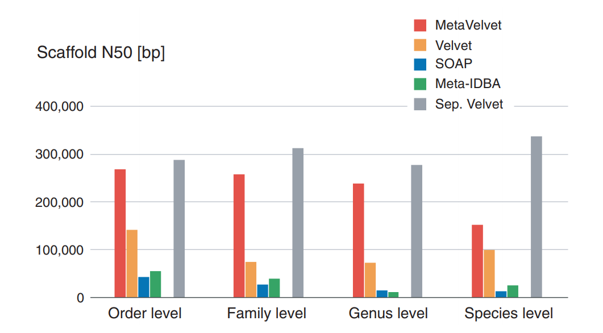

Slide 19
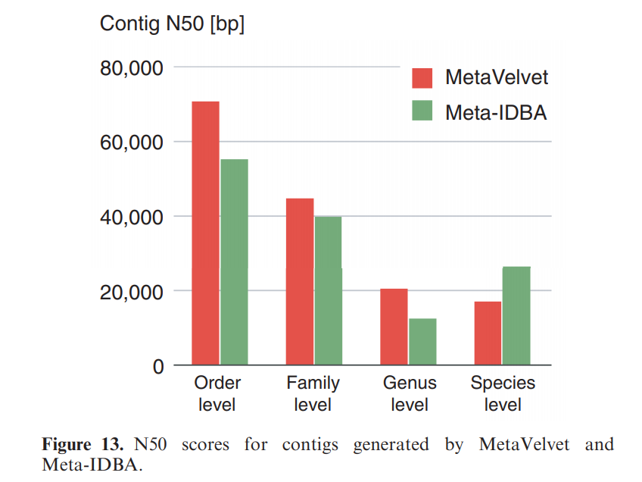

Slide 20
Best Performer
Order, Family, Genus
Species
MetaVelvet
Meta-IDBA

Slide 21
Meta-IDBA is designed to solve the metagenome assembly problem caused by polymorphisms in similar species in metagenomic environments.
In this aspect, Meta-IDBA might be more useful for analyzing slight variants in the genomes of subspecies within a same species.

Slide 22
The End
Thank You

